Slide 1
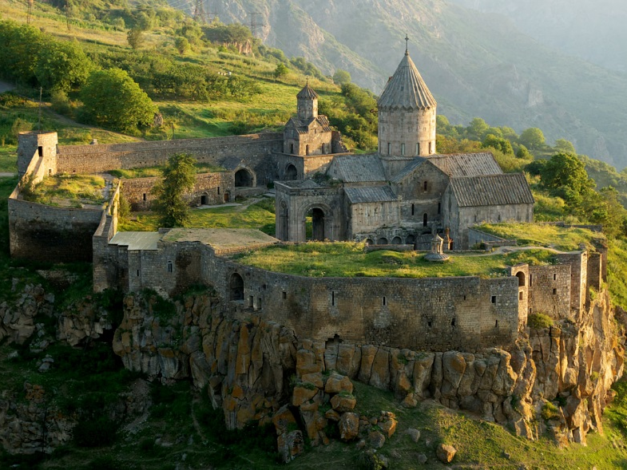

Slide 2
John 11.47-48 NET: So the chief priests and the Pharisees called the council together and said, “What are we doing? For this man is performing many miraculous signs. If we allow him to go on in this way, everyone will believe in him, and the Romans will come and take away our sanctuary and our nation.”
τόπος [TAH-pahs] = “place,”
  most likely referring to the Temple, but possibly to Jerusalem or even their position of authority.

Slide 3
Καϊάφας [kah-ee-AH-fahs] was high priest AD18-36
John 11.49-52: Then one of them, Caiaphas, who was high priest that year, said, “You know nothing at all! You do not realize that it is more to your advantage to have one man die for the people than for the whole nation to perish.” (Now he did not say this on his own, but because he was high priest that year, he prophesied that Jesus was going to die for the Jewish nation, and not for the Jewish nation only, but to gather together into one the children of God who are scattered.)

Slide 4
In the Bible, a “good” character is one who believes in God’s revelation and acts on it, one who takes the “top line.”
The “fool” is the one who turns away from God’s revelation and acts in the flesh, on the “bottom line.”

Slide 5
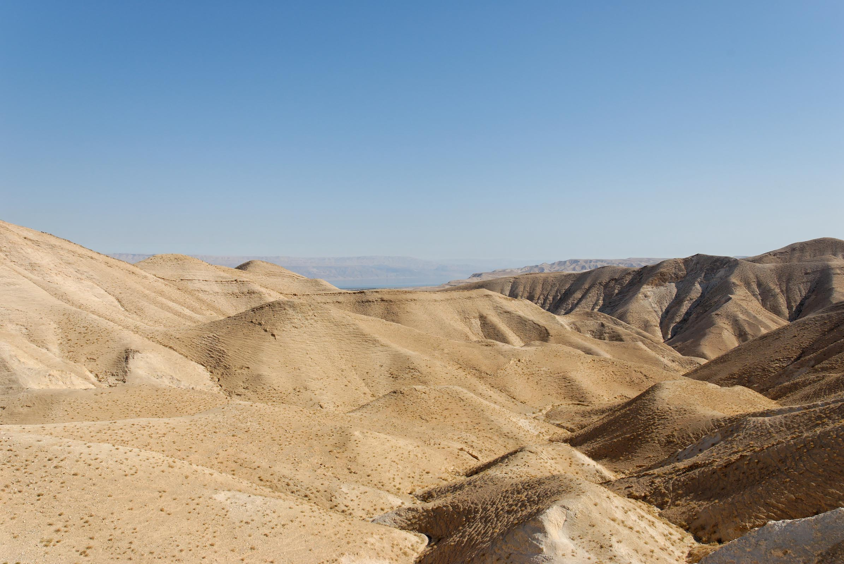
John 11.53-54: So from that day they planned together to kill him. Thus Jesus no longer went around publicly among the Judeans, but went away from there to the region near the wilderness, to a town called Ephraim, and stayed there with his disciples.
© 2012 Todd Bolen BiblePlaces.com

Slide 6
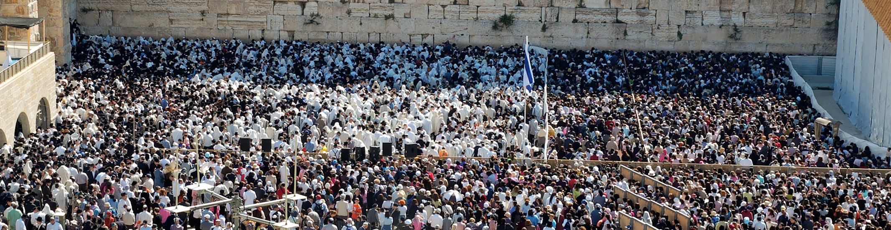
John 11.55-57: Now the Jewish feast of Passover was near, and many people went up to Jerusalem from the rural areas before the Passover to cleanse themselves ritually. Thus they were looking for Jesus, and saying to one another as they stood in the temple courts, “What do you think? That he won't come to the feast?” (Now the chief priests and the Pharisees had given orders that anyone who knew where Jesus was should report it, so that they could arrest him.)

Slide 7
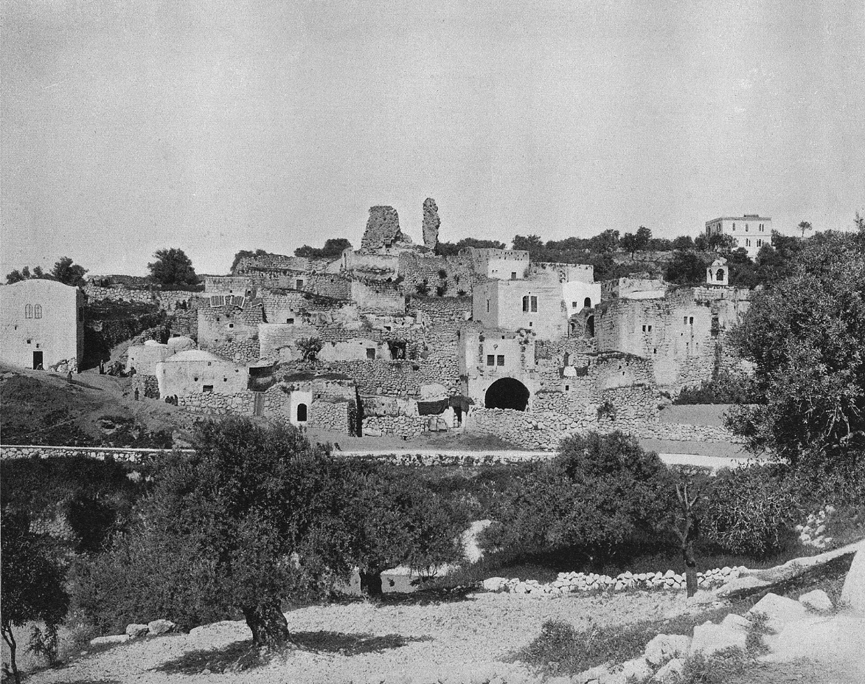
John 12.1-2: Then, six days before the Passover, Jesus came to Bethany, where Lazarus lived, whom he had raised from the dead. So they prepared a dinner for Jesus there. Martha was serving, and Lazarus was among those present at the table with him.
Village of Bethany in 1890s
from Earthly Footsteps of the Man of Galilee / © 2003 Todd Bolen

Slide 8
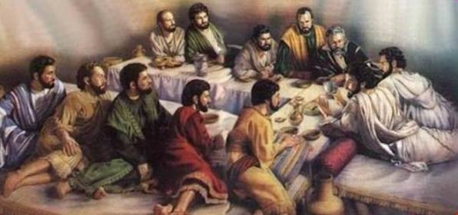
John 12.3: Then Mary took three quarters of a pound of expensive aromatic oil from pure nard and anointed the feet of Jesus. She then wiped his feet dry with her hair. (Now the house was filled with the fragrance of the perfumed oil.)
photo from beit-el.blogspot.com

Slide 9
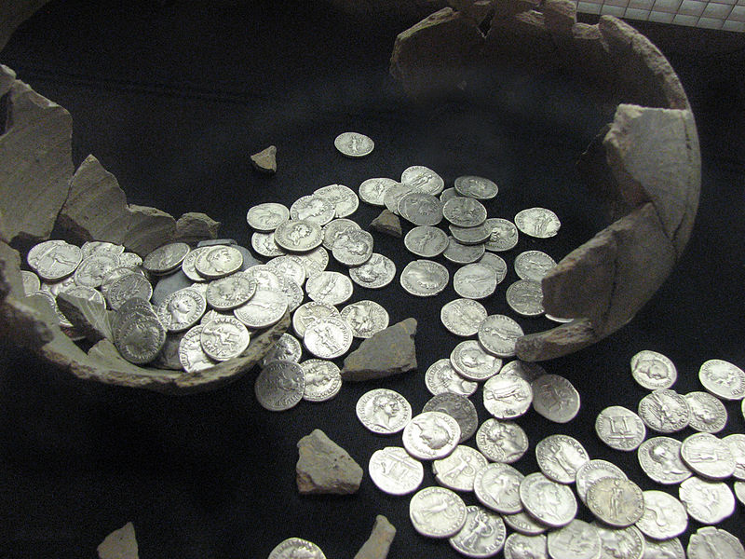
John 12.4-6: But Judas Iscariot, one of his disciples (the one who was going to betray him) said, “Why wasn't this oil sold for three hundred silver coins and the money given to the poor?” (Now Judas said this not because he was concerned about the poor, but because he was a thief. As keeper of the money box, he used to steal what was put into it.)
photo from beit-el.blogspot.com

Slide 10

John 12.4-6: But Judas Iscariot, one of his disciples (the one who was going to betray him) said, “Why wasn't this oil sold for three hundred silver coins and the money given to the poor?” (Now Judas said this not because he was concerned about the poor, but because he was a thief. As keeper of the money box, he used to steal what was put into it.)
photo from ausliebezumduft.de

Slide 11
John 12.7-8: So Jesus said, “Leave her alone.
She has kept it for the day of my burial.
For you will always have the poor with
you, but you will not always have me!”

Slide 12
John 12.7-8: So Jesus said, “Leave her alone.
She has kept it for the day of my burial.
For you will always have the poor with
you, but you will not always have me!”
          “You must pardon her, that she would keep it for the day of my burial.”
According to Deuteronomy, there should be no poor in Israel, but the people failed to keep the covenant.
Now they need the Greater Moses Prophet to reverse the curse of poverty and bring repentance.

Slide 13
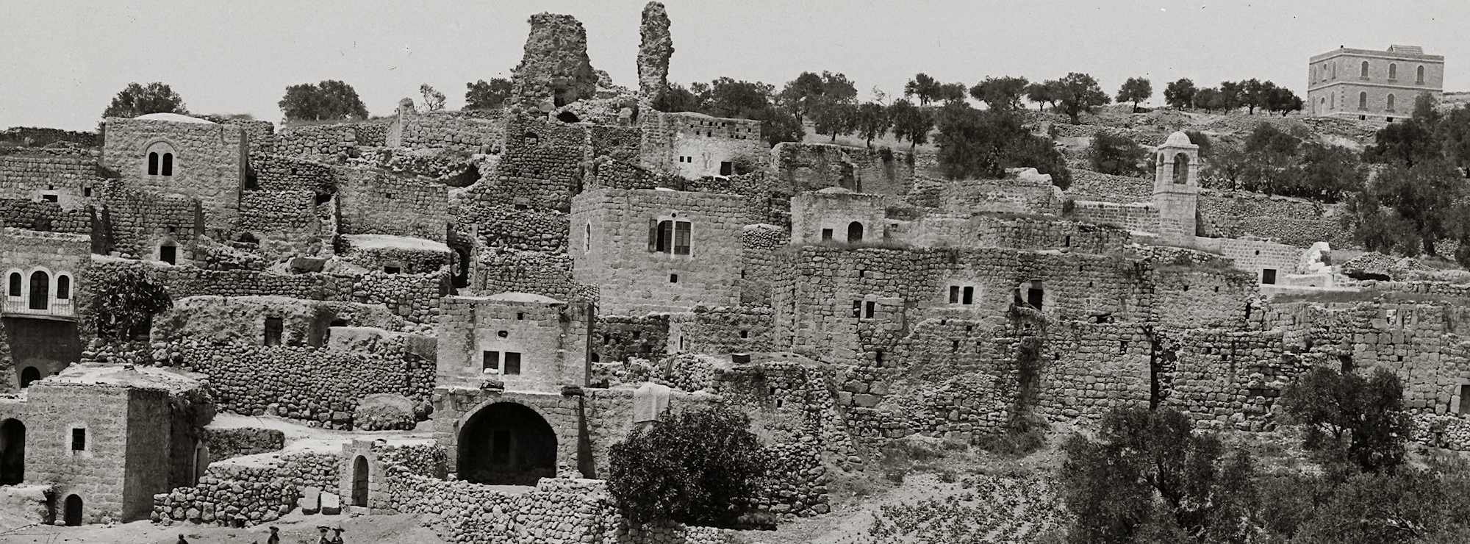
John 12.9-11: Now a large crowd of Judeans learned that Jesus was there, and so they came not only because of him but also to see Lazarus whom he had raised from the dead. So the chief priests planned to kill Lazarus too, for on account of him many of the Jewish people from Jerusalem were going away and believing in Jesus.
Eric Matson Collection ©2009 Todd Bolen / LifeintheHolyLand.com

Slide 14
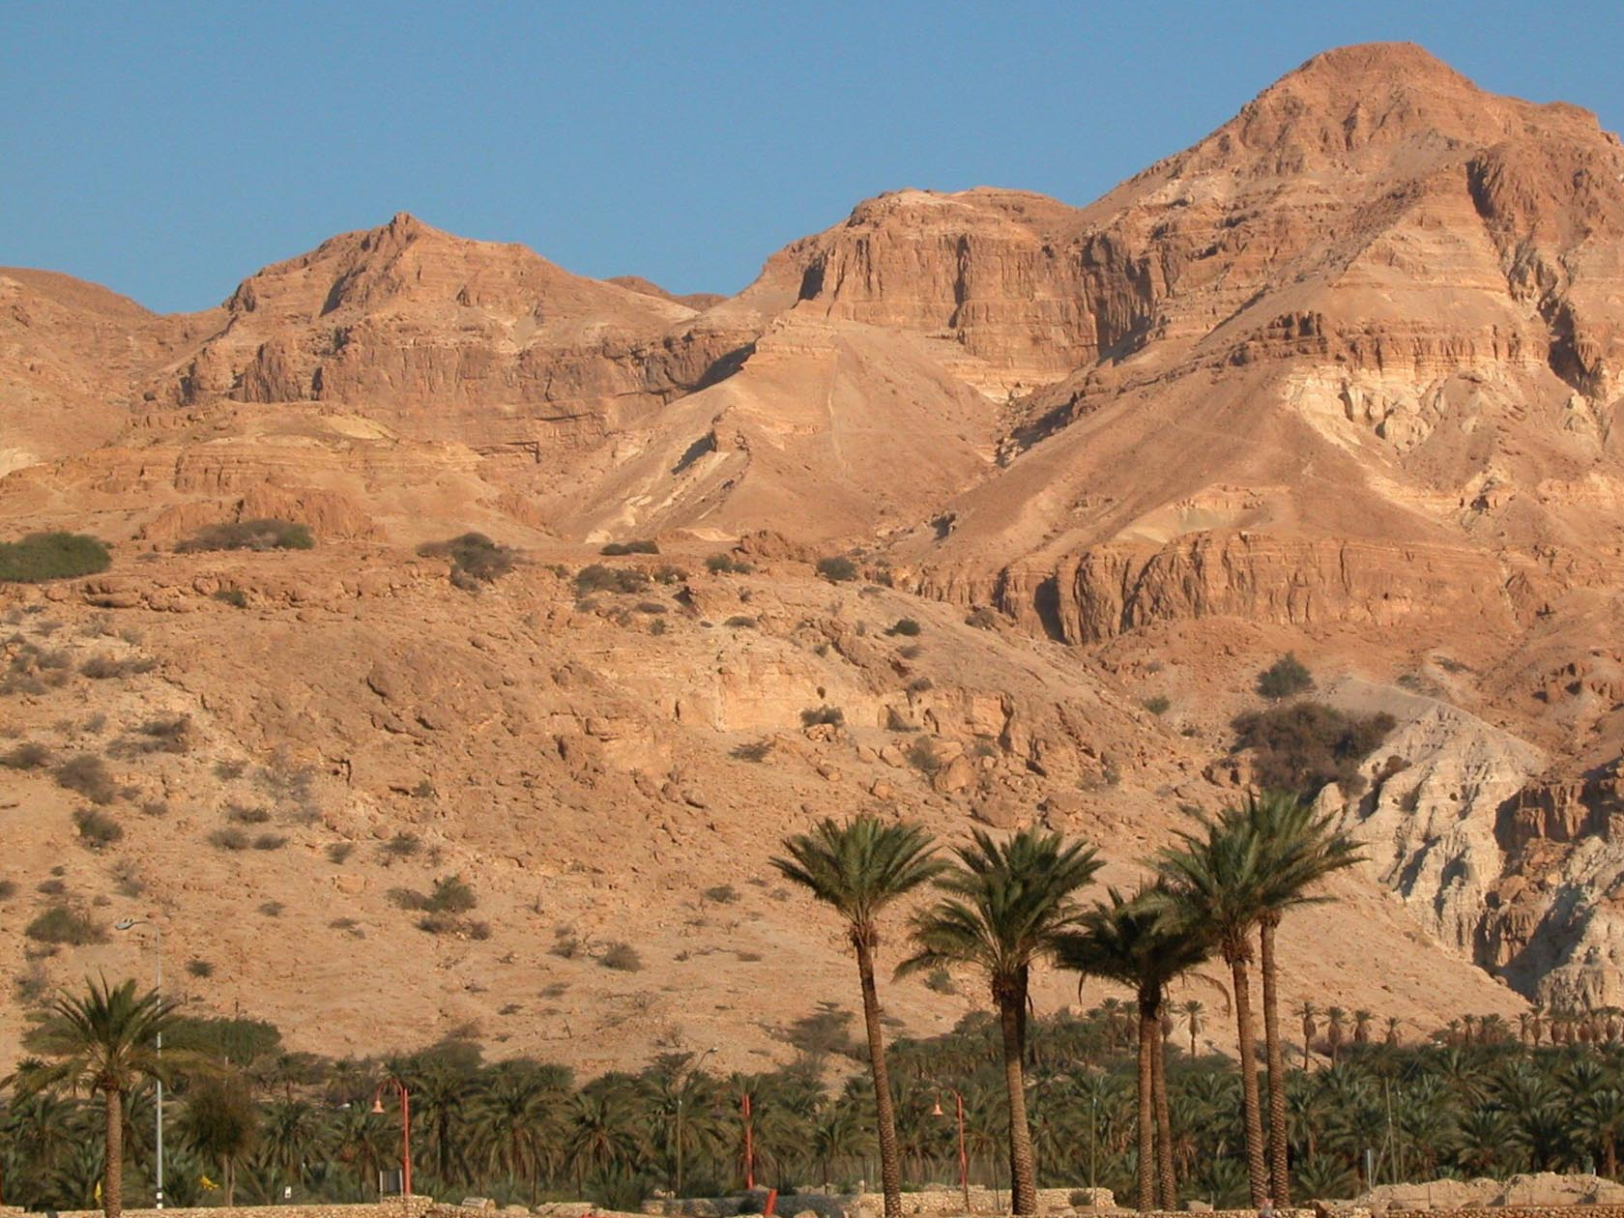
John 12.12-13: The next day the large crowd that had come to the feast heard that Jesus was coming to Jerusalem. So they took branches of palm trees and went out to meet him. They began to shout, “Hosanna! Blessed is the one who comes in the name of the Lord! Blessed is the king of Israel!”
© 2012 Todd Bolen BiblePlaces.com

Slide 15
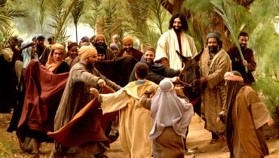
John 12.14-15: Jesus found a young donkey and sat on it, just as it is written, “Do not be afraid, people of Zion; look, your king is coming, seated on a donkey's colt!”
Jesus Revealed © Big Book Media

Slide 16
John 12.16-19: (His disciples did not understand these things when they first happened, but when Jesus was glorified, then they remembered that these things were written about him and that these things had happened to him.) So the crowd who had been with him when he called Lazarus out of the tomb and raised him from the dead were continuing to testify about it. Because they had heard that Jesus had performed this miraculous sign, the crowd went out to meet him. Thus the Pharisees said to one another, “You see that you can do nothing. Look, the world has run off after him!”

Slide 17
How much are you willing to worship?
What are you willing to sacrifice for worship?

